Slide 1
Supply Chain & Digital Behavior Analysis
Leveraging Analytics to Drive Growth, Efficiency, and Customer Value
Data Source Credit: Mendeley Data (Supply Chain Dataset by DataCo Global)
Presented BY: Jeet Sarkar
Technical Credit: SQL, Excel, PowerBI

Slide 2
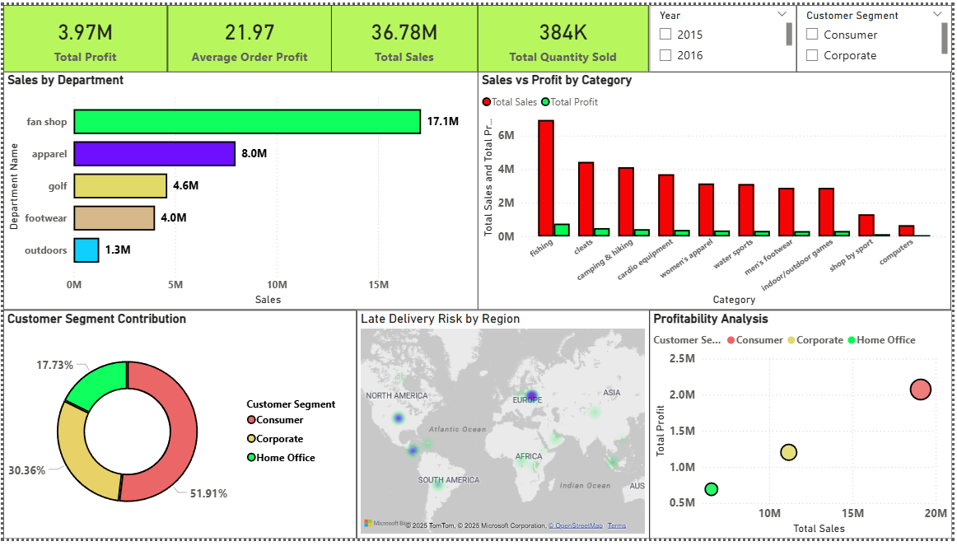
Supply Chain Analysis
Overall Performance
  Total Sales: 36.78M
  Total Profit: 3.97M
  Average Order Profit: 21.97
  Total Quantity Sold: 384K

Slide 3
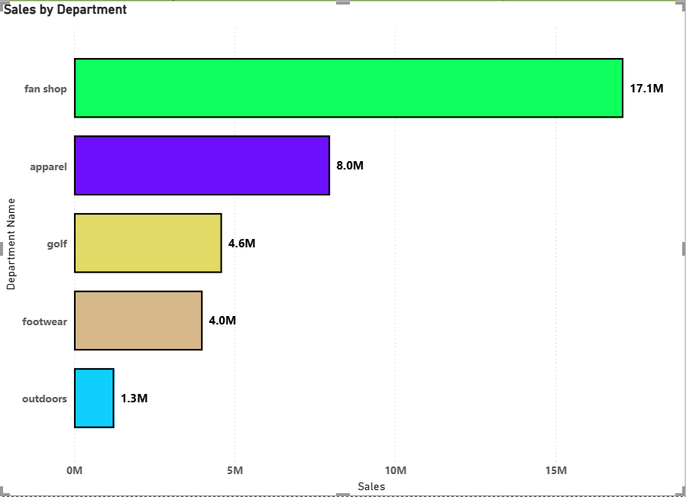
Sales by Department
Insights:
  Fan Shop is the top revenue contributor (17.1M), accounting for nearly half of total sales.
  Apparel (8.0M) and Golf (4.6M) follow.
  Outdoors contributes the least (1.3M).
Recommendations:
  Protect Fan Shop revenue with exclusive launches and loyalty offers.
  Increase cross-selling from Fan Shop to Apparel and Footwear.
  Reassess Outdoors category through pricing optimization or assortment rationalization.

Slide 4
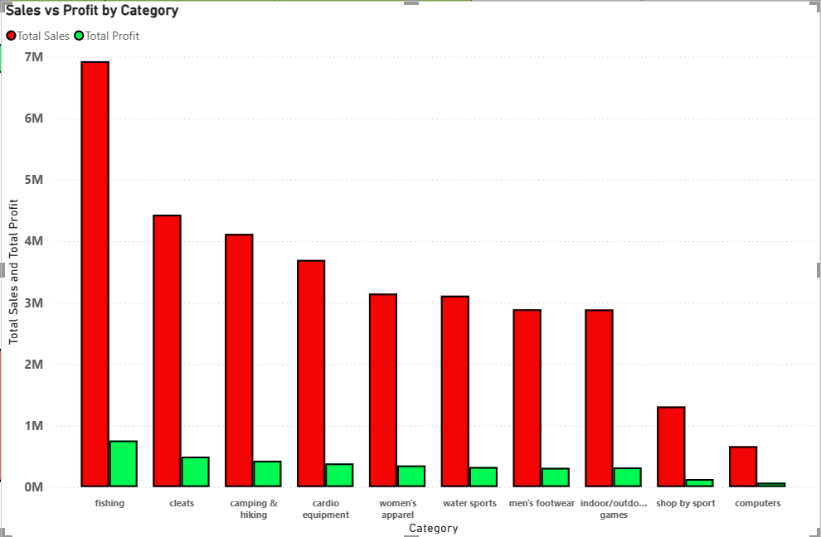
Sales vs Profit by Category
Insights:
  Fishing generates the highest sales but comparatively lower profit margin.
  Cleats and Camping & Hiking show balanced sales and profit.
  Computers and Shop by Sport underperform in both metrics.
Recommendations:
  Review supplier costs and pricing strategy for Fishing.
  Reduce excessive discounting in high-volume, low-margin categories.
  Shift marketing spend toward high-margin categories.

Slide 5
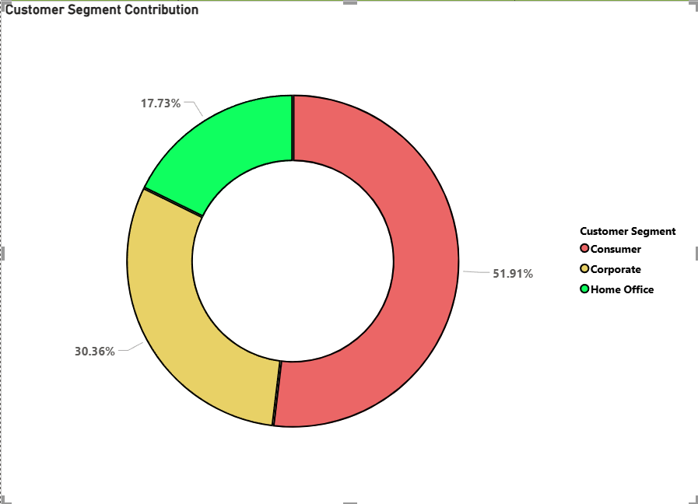
Customer Segment Contribution
Insights:
  Consumer segment dominates (51.9%) of total contribution.
  Corporate contributes 30.36%, Home Office 17.73%.
Recommendations:
  Strengthen loyalty programs and repeat-purchase incentives for Consumer customers.
  Use behavior-based targeting to upsell premium products.
  Retain high-value consumers through early access and exclusive deals.

Slide 6
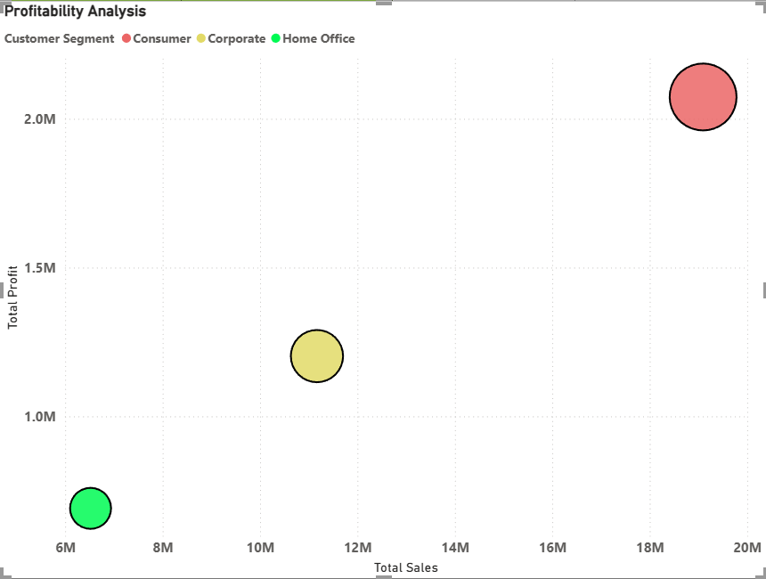
Profitability by Segment
Insights:
  Consumer segment generates both the highest sales and highest profit.
  Corporate segment has moderate sales but decent profit.
  Home Office lags in both dimensions.
Recommendations:
  Corporate segment contributes 30% but with room for expansion.
  Introduce bulk pricing, subscriptions, and contract-based offers for Corporate customers.
  Assign account-based marketing strategies to grow Corporate share.

Slide 7
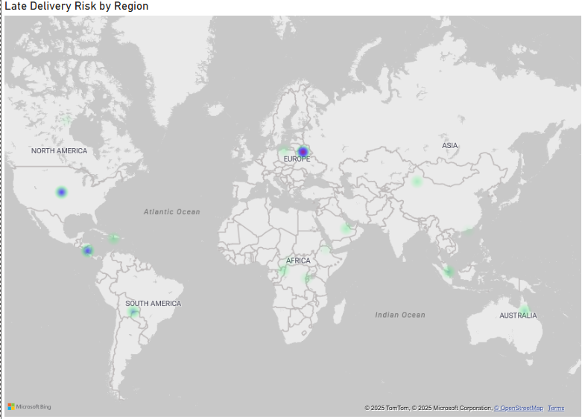
Late Delivery Risk (Heat Map)
Insights:
Delivery risks are concentrated in:
  North America
  Europe
Recommendations:
  Optimize warehouse placement and logistics partners in high-risk regions.
  Implement delivery SLA monitoring dashboards.
  Proactively communicate delays to customers to reduce churn.

Slide 8
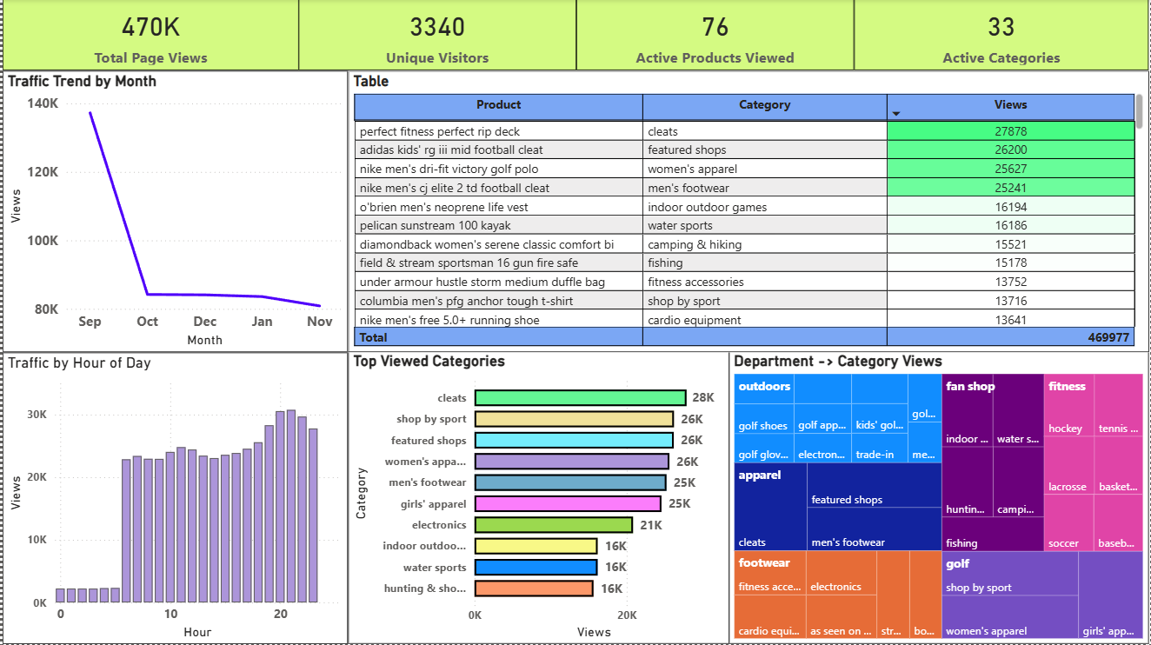
Digital Behavior Analysis
Overall Performance
  Total Page Views: 470K
  Unique Visitors: 3340
  Active Products Viewed: 76
  Active Categories Viewed: 33

Slide 9
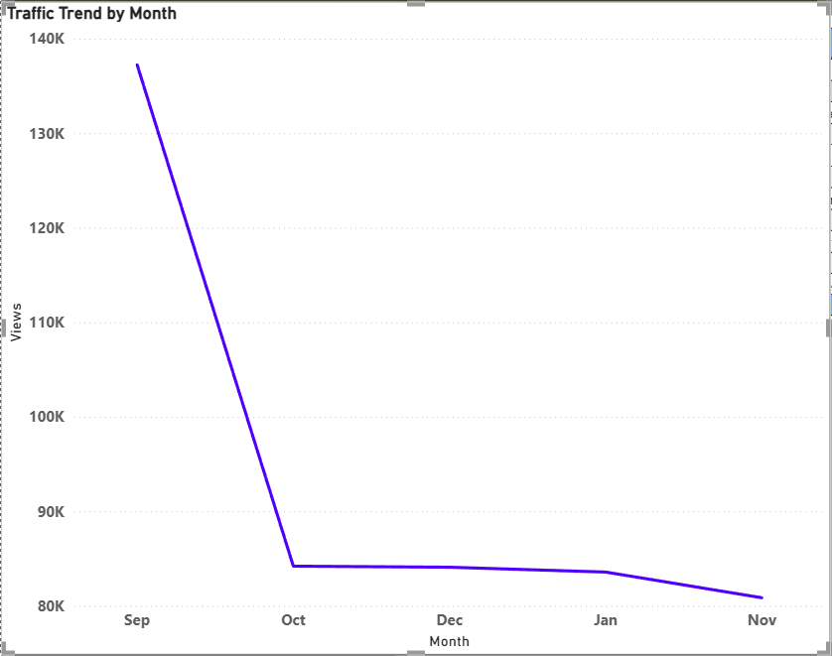
Traffic Trend (Monthly)
Insights:
  Sharp decline after September: Traffic drops significantly from ~135K in September to ~80K by November.
  This suggests:
    Seasonality impact (post-peak demand drop), or
    Reduced marketing activity / campaign dependency.
Recommendations:
  Introduce personalized product recommendations and “Recently Viewed” sections to convert browsing behavior into purchases.
  Implement exit-intent offers to capture undecided users.

Slide 10
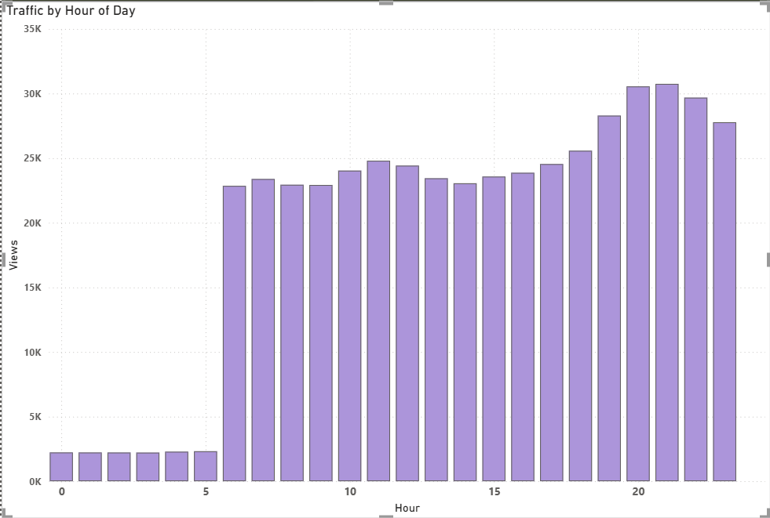
Traffic by Hour of Day
Insights:
  Peak activity occurs between 6 PM – 10 PM, with the highest around 8–9 PM.
  Early morning traffic (0–5 hrs) is minimal.
Recommendations:
  Schedule email campaigns, push notifications, and flash sales during peak evening hours.
  Optimize ad bidding and website performance for these time windows to maximize conversion.

Slide 11
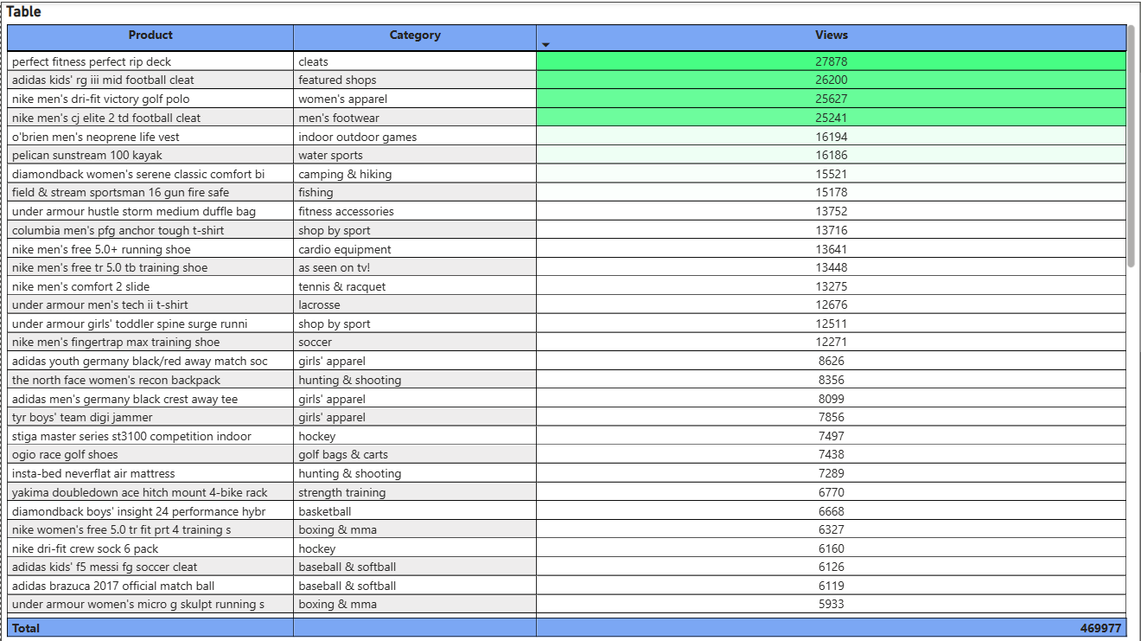
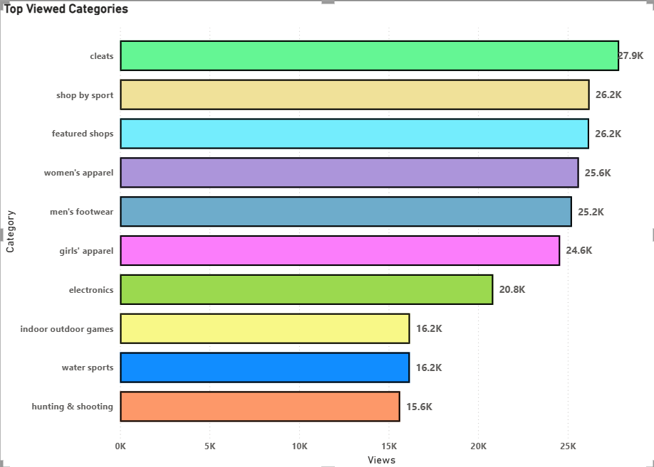
Product & Category Performance
Insights:
  Top products are dominated by fitness equipment and sports footwear.
  Highest viewed product: Perfect Fitness Perfect Rip Deck (27.8K views).
  Cleats, Shop by Sport, Apparel categories consistently rank highest in views.
Recommendations:
  Prioritize inventory availability and ad spend for top-viewed products.
  Create product bundles combining high-view and low-view products to increase basket size.
  Highlight best-viewed products on homepage and category landing pages.
  Optimize category landing pages with filters, comparisons, and featured collections.
  Use category-level promotions instead of only product-level discounts.
  Expand assortment within high-interest categories to capture unmet demand.

Slide 12
Strategic Summary
Area | Key Action
Traffic | Replicate seasonal success & push evening campaigns
Products | Focus on Fitness, Footwear, Cleats
Revenue | Protect Fan Shop, optimize low-margin categories
Customers | Retain Consumers, expand Corporate
Operations | Reduce delivery risk in key regions

